Slide 1

Women apprentices state-by-state
Ariane Hegewisch
hegewisch@iwpr.org
National Taskforce on Tradeswomen’s Issues Convening
Chicago, September 21, 2025

Slide 2
In response to the Trump Administration’s NPRM on “Prohibiting Illegal Discrimination in Registered Apprenticeship Programs” show that:
Big increase in the number of women construction apprentices since the start of the American Apprenticeship Initiative in 2016 and the 2017 update of 29/30 regulations.
Women are still severely underrepresented.
Progress is much higher in some states than others.

Slide 3
Glas half full
From 2015 and 2024, the number of women construction apprentices (in the 37 states in RAPIDS) almost tripled from 3,789 to 10,834.
  Four states have more than 1,000 women construction apprentices - California*, New York*, Texas, and Washington*.
Very diverse women workforce (52% White; 25.3% Latinas; 12.6% Black women; 3.7% Native; 1.4% Asian; 0.9% Hawaiian & Pacific Islanders)
From 2015 to 2024, women’s share of apprenticeships increased from 3.0% to 5.5% .
  Five states have at least 9% women-
  Maine (10%, but few in numbers), Arizona (10%), Oregon* (9.5%), Massachusetts* (9.2%) and New York* (9.0%).
Note on data sources and comparability: * Data for CA, MA, NY, OR, and WA are our analysis of data provided by the relevant state
apprenticeship offices because they are either completely missing or under-reported in the DOL RAPIDS data base; however, that means that they may not be fully comparable, for example including trade apprentices working in other industries than construction.
Data for Massachusetts only include joint and non-joint construction apprenticeships, not capturing other construction sponsors in the state.

Slide 4
Glas quite empty
From 2015 and 2024, the share of women construction apprentices (in the 37 states in RAPIDS) only increased from 3.0 to 5.5%.
In 7 states, women’s share is less than 3.5% - including California* (3.2%), Mississippi (3.2%), Nebraska (2.9%), Maryland (2.8%), Arkansas (2.7%), Delaware (2.4%) and South Dakota (1.5%)
DOL RAPIDS data are a great source (but need to double-check gender data) https://www.apprenticeship.gov/data-and-statistics/apprentices-by-state-dashboard .
  Build relationships with state apprenticeship offices and apprenticeship programs…

Slide 5
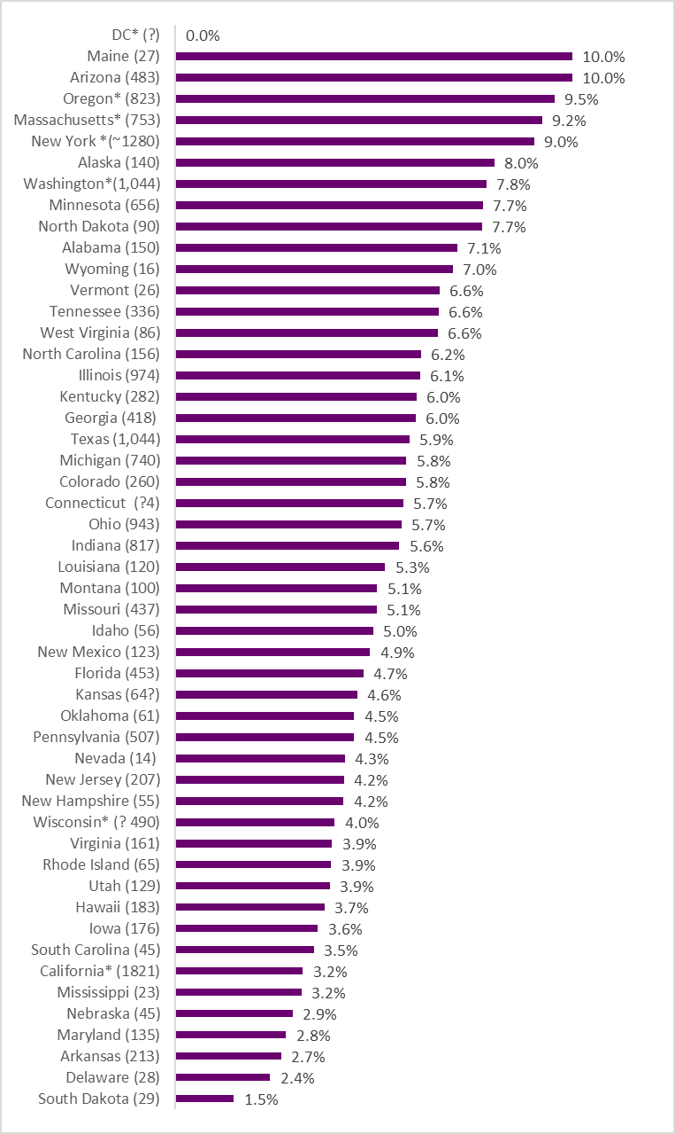
Women’s share of construction apprenticeships, 2024*
Sources: IWPR compilation from RAPIDS (2024 Q4= FY2025 Q1) and state sources (2024 ish); % female is based only on apprentices with either male or female identification. RAPIDS data only for construction industry apprenticeships. * Data from state apprenticeship office; MA data only joint & non-joint construction sponsors; may also include trade apprentices (e.g. electricians) in industries other than construction.

Slide 6
Data sources and research on women apprentices
The DOL RAPIDS Database Registered apprentices by state/ gender/ race/ethnicity/occupation/industry: includes reasonable data for about 40 states). https://www.apprenticeship.gov/data-and-statistics/apprentices-by-state-dashboard
ICERES: The State of Registered Apprenticeship Training in the Construction Trades – 2024 (Cihan Bilginsoy and Russell Ormiston) https://iceres.org/ (not available on line)
Institute for Women’s Policy Research resources:
IWPR Quick figure “Numbers Matter: Women Working in Construction” – with data for 2015 and 2024, including for construction apprentices. https://iwpr.org/numbers-matter-women-working-in-construction-3/
IWPR Quick Figure: Chart average hourly wages for women & men who completed apprenticeships in FY 2024, by race/ethnicity – for all apprentices but including some construction data Women Need Better Access to High-Paying Apprenticeships
IWPR Report on women & apprenticeship - includes a chapter on construction apprenticeships. As Apprenticeships Expand, Breaking Down Occupational Segregation Is Key to Women’s Economic Success IWPR report #C522 , https://iwpr.org/as-apprenticeships-expand-breaking-down-occupational-segregation-is-key-to
Individual states:
Illinois: The Impact of Pre-Apprenticeship Programs in Illinois, Illinois Economic Policy Institute; 2025 https://cwit.org/wp-content/uploads/2025/08/ilepi-pmcr-impact-of-pre-apprenticeship-programs-in-illinois-final.pdf
New York: NYSDOL Apprenticeship Update (Feb 2025) NYSDOL Apprenticeship Update (February 2025)
Oregon: “Recruitment and Retention of Apprentices in the Construction Trades” Lindsey Wilkinson & Maura Kelly (data from 2010/11 to 2022/23 ) Factsheet-2024-Recruit-Retention-Apprentices-Construction-Trades.pdf; and “Evaluation of the Highway Construction Workforce Development Program October 2024” Lindsey Wilkinson and Maura Kelly. 2024-Eval-Highway-Construction-Workforce-Dev-Prog.pdf
Wisconsin: “Registered Apprenticeship Programs in Wisconsin’s Construction Industry The Joint Labor-Management Advantage” ; Frank Manzo IV, Jacob Hager, and Robert Bruno (May 2025; 2022 data, with a bit of data on gender) https://lep.illinois.edu/wp-content/uploads/2025/05/PMCR-Registered-Apprenticeship.pdf
Wisconsin: Bureau of Apprenticeship Standards - Year in Review; (on p.10 is a little bit of data on gender- women’s share of new apprentices).

